Slide 1
Software Engineering BCA IV SEM
Chapter V
Coding
Bijay Babu Regmi
bijay.regmi@deerwalk.edu.np

Slide 2
Coding
The coding is the process of transforming the design of a system into a computer language format. This coding phase of software development is concerned with software translating design specification into the source code. It is necessary to write source code & internal documentation so that conformance of the code to its specification can be easily verified.
Coding is done by the coder or programmers who are independent people than the designer. The goal is not to reduce the effort and cost of the coding phase, but to cut to the cost of a later stage. The cost of testing and maintenance can be significantly reduced with efficient coding.
Goals of Coding:
to translate the design of system into a computer language format: The coding is the process of transforming the design of a system into a computer language format, which can be executed by a computer and that perform tasks as specified by the design of operation during the design phase.
to reduce the cost of later phases: The cost of testing and maintenance can be significantly reduced with efficient coding.
making the program more readable: Program should be easy to read and understand. It increases code understanding having readability and understandability as a clear objective of the coding activity can itself help in producing more maintainable software.

Slide 3
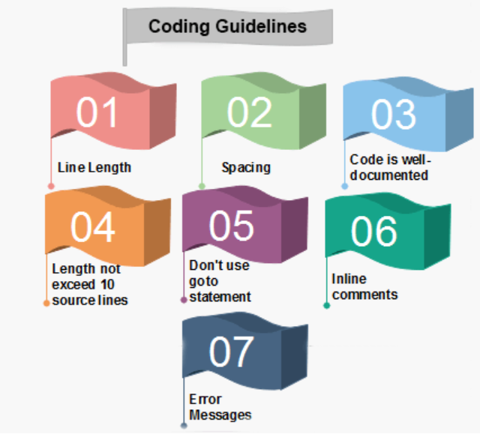
Coding Guidelines

Slide 4
Continued....
1. Line Length: It is considered a good practice to keep the length of source code lines at or below 80 characters. Lines longer than this may not be visible properly on some terminals and tools. Some printers will truncate lines longer than 80 columns.
2. Spacing: The appropriate use of spaces within a line of code can improve readability.
Example:
Bad: cost=price+(price*sales_tax)
fprintf(stdout ,"The total cost is %5.2f\n",cost);
Better: cost = price + ( price * sales_tax )
fprintf (stdout,"The total cost is %5.2f\n",cost);

Slide 5
Continued....
3. The code should be well-documented: As a rule of thumb, there must be at least one comment line on the average for every three-source line.
4. The length of any function should not exceed 10 source lines: A very lengthy function is generally very difficult to understand as it possibly carries out many various functions. For the same reason, lengthy functions are possible to have a disproportionately larger number of bugs.
5. Do not use goto statements: Use of goto statements makes a program unstructured and very tough to understand.
6. Inline Comments: Inline comments promote readability.
7. Error Messages: Error handling is an essential aspect of computer programming. This does not only include adding the necessary logic to test for and handle errors but also involves making error messages meaningful.

Slide 6
Programming Languages and Development Tools
Programming Language (PL) is a formal language that specifies a set of instruction for computer to do something.
PL should be seen from three points: specification, reference implementation and vendor implementation
Developmenet Tools (DT) are a set of tools to help software developer in doing their tasks to create software product:
- IDE (Integrated Development Environment)
- Compiler / Intepreter
- Profiler
- Debugger
- Editor
- Package Management
- Programming Environment

Slide 7
Programming Paradigms
Programming Paradigm is related with the way programmer solve programming problem.
PP are implemented as programming language features.
Some Programming Paradigms are
- Imperative: allow side effects, sequential, there are constructs to control order. For ex: Perl, Python, JavaScript, PHP
- Functional Programming: disallow side effects, treats computation as the evaluation of mathematical functions, avoids changing state and mutable data. For ex: Haskell, OCaml
- Declarative: order is not important, declare something and have computer do the work. For Ex: SQL
- Object Oriented Programming: treats class as an encapsulation of executable code and let the objects from the class to collaborate. For Ex: Java, C++

Slide 8
Programming Environment
PL is not the only thing to consider when we want to build software product
PL environment are other things related to programming and DT, important for successful delivery of software products although may not be technically related.
It is the answer of: “I can program, I can do programming tasks, now how should I begin and how do I manage it so that I can deliver software product?”
PL environment:
- Software development methodology:waterfall, prototyping, agile
- Cloud-enabled DT (platform as a service): Docker,Kubernetes, ekt, unikernel
- Distributed Computing: Data serialization: XML (OBSOLETE), JSON, msgpack, protocol buffer, etc.
- Testing and Continous Integration
- Online tools: workflow management (ex: trello), communication (Slack)
- Project Management: Github, Gitlab
- Product Development: Aha (aha.io)

Slide 9
Domain Problems
Frontend:
- GUI and TUI
- Web
- Mobile
Backend - Distributed System: low latency PL
- PL - Compiler and libraries: microservices. Go is still the best
- Database: SQL, NOSQL, NewSQL
Big Data
Artificial Intelligence: Machine Learning and Data Mining (ex: TensorFlow), Deep Learning: see Julia and R
Embedded System: Raspberry Pi etc: need specific OS and specific development tools: Python, Node.js, Rust, Go, C

Slide 10
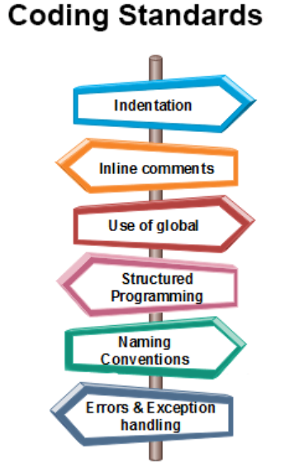
Coding Standards

Slide 11
Continued....
Indentation: Proper and consistent indentation is essential in producing easy to read and maintainable programs. Indentation should be used to:
- Emphasize the body of a control structure such as a loop or a select statement.
- Emphasize the body of a conditional statement
- Emphasize a new scope block
Inline comments: Inline comments analyze the functioning of the subroutine, or key aspects of the algorithm shall be frequently used.

Slide 12
Continued....
Rules for limiting the use of global: These rules file what types of data can be declared global and what cannot.
Structured Programming: Structured (or Modular) Programming methods shall be used. "GOTO" statements shall not be used as they lead to "spaghetti" code, which is hard to read and maintain, except as outlined line in the FORTRAN Standards and Guidelines.
Naming conventions for global variables, local variables, and constant identifiers: A possible naming convention can be that global variable names always begin with a capital letter, local variable names are made of small letters, and constant names are always capital letters.
Error return conventions and exception handling system: Different functions in a program report the way error conditions are handled should be standard within an organization. For example, different tasks while encountering an error condition should either return a 0 or 1 consistently.

Slide 13
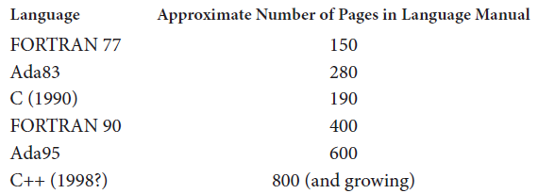
Selecting Languages and Tools
It is important to understand that the choice of a programming language for implementation of a system is often made on nontechnical grounds.
For example, market pressures, the availability of particular compilers, existence of software tools and development environments, or the experience of the software engineering staff may be more important than the perceived technical advantages of any particular language.
Technical issues in programming-language selection include such things as ease of integration with existing software components, adherence to technical mandates, real-time or other performance requirements, and the need to keep staff members happy by giving them access to new technologies.
Fig: Size of several computer language manuals

